Slide 1

Microsoft Project Custom Reporting with Excel
November 3rd 2021 @12-1 PM ET Jeff Chamberlain, PMP, CSM
Activity # is Mpug110321

Slide 2
Project Setup and Notes

Slide 3
Project Schedule Best Practices
Status date versus current date
Use status date as it confirms project scheduling activities have been completed, confirmed and updated in the MPP file.
Current date requires the file to be saved (and published) on Project Server to be refreshed.
Project flags in schedule will revert to values in the export file to Excel, not as visuals.
You can’t sort by visuals in Project, i.e. flags, checks, etc.
Durations in many fields translate to minutes in order to accurately calculate a business day.

Slide 4
Class Goals
At the end of this course my goal is for the attendees to:
Microsoft Project
See how custom columns in Project can be created to allow for a consistent export of schedule data.
Learn how to create custom formulas to display helpful values for Excel reporting.
Identify important columns required for Excel reporting
Set up custom views and filters to quickly return schedule views for exporting.
Microsoft Excel
Identify key benefits of Excel Reporting
See the importance of PowerQuery in the data transformation process.
Use tables and visuals to report on project data
Learn the ease of regular data refresh.

Slide 5
Custom MSP Columns with Formulas
Name | Formula | Purpose
Days From Start | Format((ProjDateDiff(Now(),[Start],"standard"))/480,0) | The difference in (8 hour) business days between the current date and planned start date. Current date is last date file was saved
Days from Finish | Format((ProjDateDiff(Now(),[Finish],"standard"))/480,0) | The difference in (8 hour) business days between the current date and planned finish date. Current date is last date file was saved.
Days Since Completed | IIf([Actual Finish]=ProjDateValue("NA"),"",Format(ProjDateDiff([Actual Finish],[Status Date],"standard")/480,"#")) | Calculates the number of (8 hour) business days since a task has been marked as complete, using the actual finish date.
Actual Start (Custom, not default) | IIf([Actual Start]=projdatevalue("NA"),"",[Actual Start]) | Suppresses “NA” to eliminate errors in the PowerQuery
Actual Finish (Custom, not default) | IIf([Actual Finish]=projdatevalue("NA"),"",[Actual Finish]) | Suppresses “NA” to eliminate errors in the PowerQuery
Key Deliverable (do not use milestone) | Graphical Indicator based on Yes/No selection | PM sets a Yes/No flag to indicate the task is a key deliverable or event.

Slide 6
Red/Amber/Green Fields
Name | Formula | Purpose
Status (Start) + | Switch(([% Complete]=100),"C",([Days from start +]<0),"R",([Days from start +]>=0 And [Days from start +]<=89),"A",([Days from start +]>=90),"G",True,"ERROR!") | This formula generates a C for all completed tasks, An “R” for all tasks earlier than today, an “A” for tasks between 0 and 80 days out, and a “G” for all tasks beyond 90 days. These are then changed into symbols as identified below.
Status (Finish) + | Switch(([% Complete]=100),"C",([Days from finish +]<0),"R",([Days from finish +]>=0 And [Days from finish +]<=89),"A",([Days from finish +]>=90),"G",True,"ERROR!") | This formula generates a C for all completed tasks, An “R” for all tasks earlier than today, an “A” for tasks between 0 and 80 days out, and a “G” for all tasks beyond 90 days. These are then changed into symbols as identified below.
Value | Definition | Symbol
“R” | Status is red, meaning task start or finish date* is earlier than the current date
“A” | Status is amber, meaning the task start or finish date* is 0 to 89 days out
“G” | The status is green, meaning the task start or finish date is 90* days or more out
“C” | The task has been marked 100% complete.
* Task Start or Finish dates refer to the specific Microsoft Project fields.
NOTE: Numeric values in the Status formulas can be changed to preferred ranges.

Slide 7
Additional Custom MSP Columns
Name | Formula | Purpose
Hub | Look up value, or drop down, depending on configuration. | Provides a logical grouping of activities for a custom view. Name this whatever you want to meet your requirements.
Work Stream | Look up value, or drop down, depending on configuration. | Provides a logical grouping of activities for a custom view. Name this whatever you want to meet your requirements.
PM | Look up value, or drop down, depending on configuration. | Provides a logical grouping of activities for a custom view

Slide 8
Additional Fields of Note
Name | Value | Purpose
Summary | Yes/No | Allows the Excel report to suppress values associated with this row to eliminate incorrect values being reported.
Unique ID | Auto Assigned Number | Creates a fixed ID for Excel to use when querying records.
Active | Yes/No | Allows the Excel report
Critical | Yes/No | Indicates if a task is on the critical path or if there is any slack

Slide 9
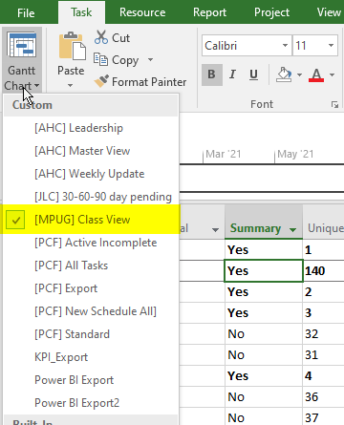
Custom View
Add all columns required for export and order them.
Select Save View
Use brackets ([]) and name it as shown)
Easily return to view when exporting updated schedule values.

Slide 10
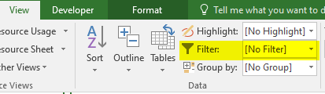
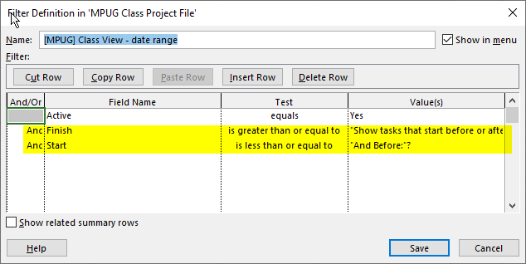
Custom Filter/Active Filter
Add a custom filter using the same naming convention as the view.
Filter on field name “Active”=“yes”.
Optional – Add a date range as shown

Slide 11
Demo Time!

Slide 12
Excel Setup and Notes

Slide 13
Why Use Excel?
Data democratization
You can’t sort by visuals in Project
Tool availability
It just makes sense
While some of the processes here may be complicated, but these are one time set up concerns
Process is automated and repeatable

Slide 14
Process

Slide 15
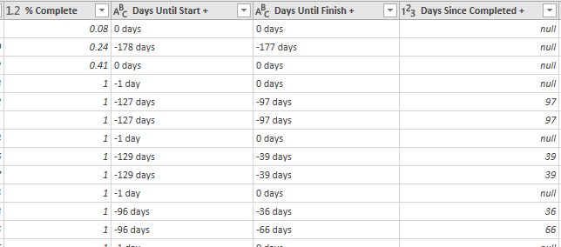
Excel Transformations
Percent is displayed as a decimal.
MS Project Exports the value and label “days” in the same cell
Blank values come over as “null”

Slide 16
Excel Transformations
Formula | Expected Result | Purpose
=CONCATENATE("Last Update ",(TEXT('File Info'!D5,"MM-DD-YYY"))) | Displays “Last Update MM/DD/YYY” | This pulls the “last modified field from the file info table in order to give a general date the file was last refreshed from a data standpoint.
=IF(AND(B$36>=$G38, B$36<=$H38),1,#N/A) | Shows a “1” or “N/A” | This is used for the RAG table to make the stoplights work for each category
=SERIES("1",{1,1,1},{1,2,3},1) | Not a result, but an effect | This looks for a value of one in the formula above, when present, it highlights the visual to show a red/amber/green filled circle.

Slide 17
Demo Time!

Slide 18
Key Metrics
Put title under each visual

Slide 19
Secondary
Metrics

Slide 20

Microsoft Project Custom Reporting with Excel
June 30, 2021 @ 12pm-1pm EST Jeff Chamberlain PMP, CSM
Jchamberlain@EdwPS.com, 410-570-4767
This session is eligible for 1 PMI® PDUs in the Technical category. Activity # is Mpug110321
800.556.2506 | www.EdwPS.com

